Slide 1
AP Seminar
September 7, 2016

Slide 2
Remind
Text this message to 81010:
@2fa72

Slide 3
Scott’s Scholars
http://scottscholarshawknation.weebly.com/

Slide 4
List of Colleges and Universities that Acknowledge and Accept Capstone for College Credit:
https://advancesinap.collegeboard.org/ap-capstone/higher-education-support

Slide 5
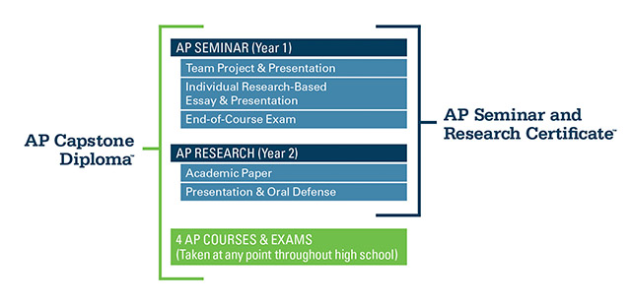

Slide 7
Team Project and Presentation—20%
Individual Research Report – Due January 28
Topic selected by group
Written independently (each group member selects a different perspective of same topic)
1200 Words (approximately xx pages)
Team Multimedia Presentation and Defense – Due February 10
3-5 students per group
6-8 minutes

Slide 8
Individual Research-Based Essay and Presentation—35%
Individual Written Argument—Due April 6 and 7
Topic individually selected based on stimulus materials
2000 words (approximately xx pages)
Individual Multimedia Presentation—Due April 21
Summarizes argument
6 to 8 minutes
Oral Defense
Answer two questions

Slide 9
End-of-Course Exam—45%
Exam Date: May 4th
Exam Length: 2 hours
Part A: Analyze an argument (3 short answers; 30 minutes)
Part B: Write an argument incorporating 2 out of 4 sources (90 minutes)

Slide 10
QUEST Framework
Question and Explore
Understand and Analyze Arguments
Evaluate Multiple Perspectives
Synthesize Ideas
Team, Transform, and Transmit

Slide 11
Crucial skills this year
Work with others to question, collaborate, discuss, brainstorm, edit, revise, etc.
Analyze arguments
Develop research questions
Answer questions through research
Evaluate research
Synthesize research
Cite sources

Slide 12
Hawk Nation!!!
One of the BEST high schools in the nation!
National: Top 8% (2170 out of 26,407)
Texas: Top 5% (183 out of 3,709 Texas)

